Slide 1

Control Structures II (Repetition)

Slide 2
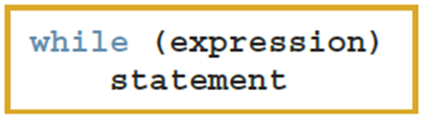
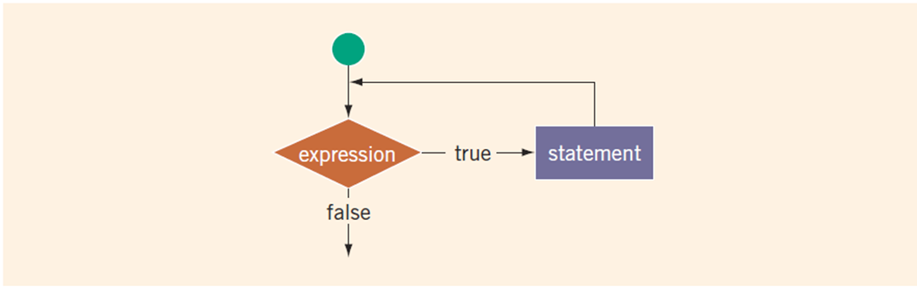
while Loop
The statement (body of the loop) continues to execute until the expression is no longer true
An infinite loop continues to execute endlessly
https://replit.com/@btaylan/CISC3142Codes#Lecture-4/1.cpp

Slide 3
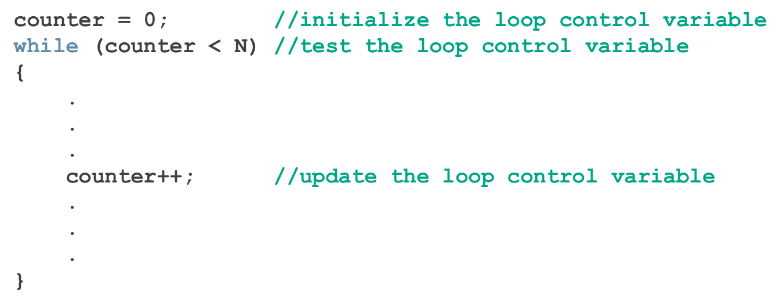
Counter-Controlled while Loops

Slide 4
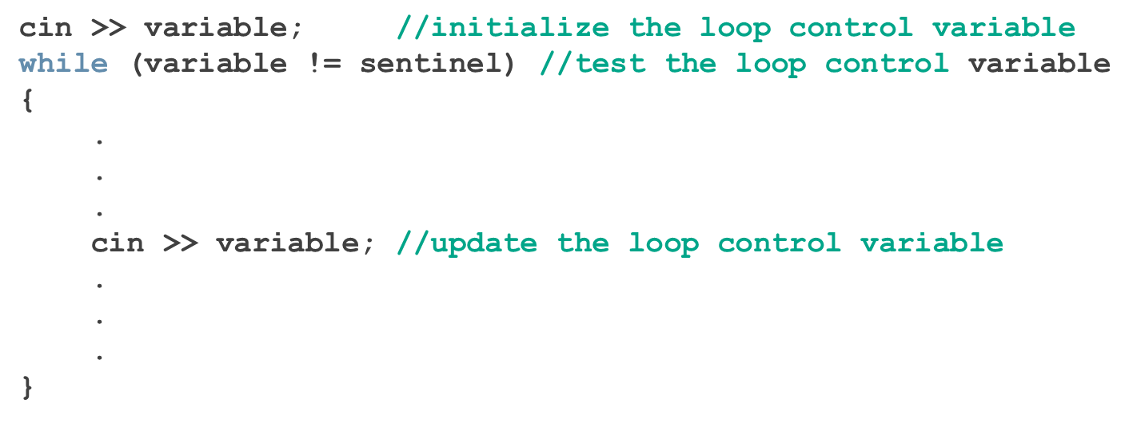
Sentinel-Controlled while Loops
A sentinel variable is tested in the condition
The loop ends when the sentinel is encountered

Slide 5
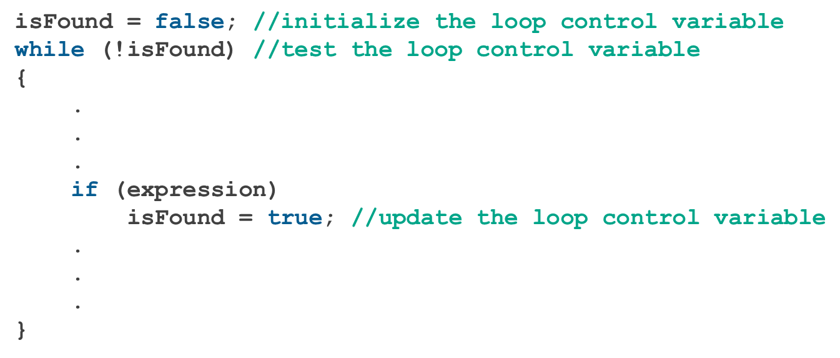
Flag-Controlled while Loops
Flag-controlled while loop: uses a bool variable to control the loop

Slide 6
EOF-Controlled while Loops
An end-of-file (EOF)-controlled while loop is a good choice when it is difficult to select a sentinel value
The logical value returned by cin can determine if there is no more input
If the program has reached the end of the input data, the input stream variable returns the logical value false .
If the program reads any faulty data (such as a char value into an int variable), the input stream enters the fail state. In this case, the input stream variable returns the value false .
https://replit.com/@btaylan/CISC3142Codes#Lecture-4/2.cpp

Slide 7

eof Function
The function eof can determine the end of file status
eof is a member of data type istream
Syntax for the function eof
istreamVar is a place holder for an input stream variable, such as cin
https://replit.com/@btaylan/CISC3142Codes#Lecture-4/3.cpp

Slide 8
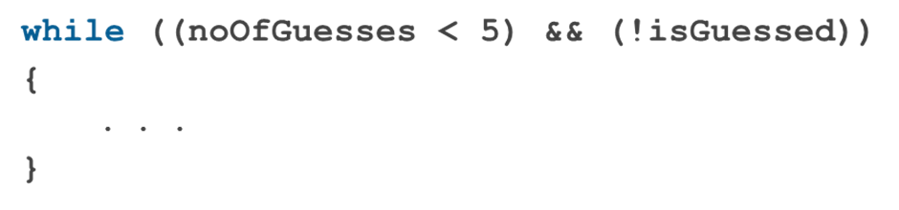
More on Expressions in while Statements
The expression in a while statement can be complex
The example is mixture of a counter control and a flag control

Slide 9
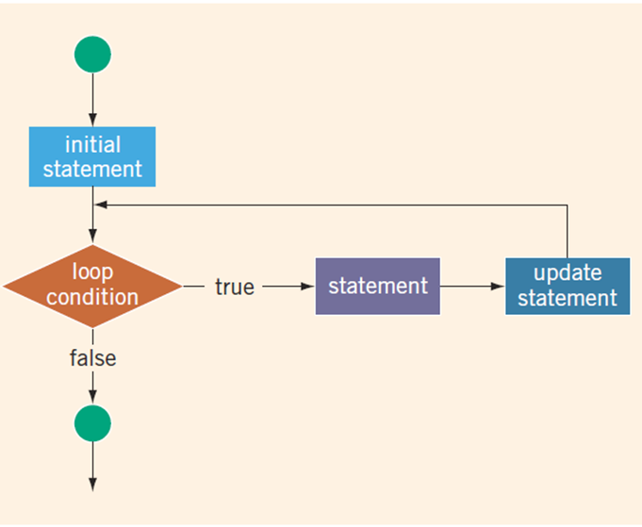
for Looping (Repetition) Structure
The initial statement, loop condition, and update statement are called for loop control statements
https://replit.com/@btaylan/CISC3142Codes#Lecture-4/4.cpp
https://replit.com/@btaylan/CISC3142Codes#Lecture-4/5.cpp
https://replit.com/@btaylan/CISC3142Codes#Lecture-4/6.cpp

Slide 10
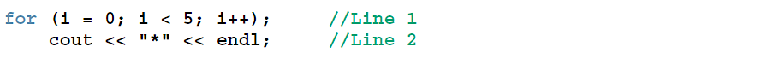
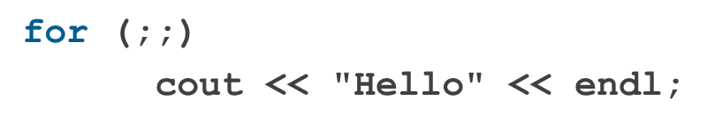
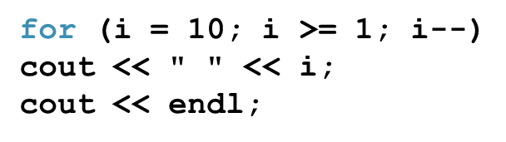
for Looping (Repetition) Structure
cout is not part of the loop!
Infinite For Loop:
Count backwards :

Slide 11
break and continue Statements
break and continue alter the flow of control
break statement is used for two purposes:
To exit early from a loop
To skip the remainder of a switch structure
https://replit.com/@btaylan/CISC3142Codes#Lecture-4/7.cpp

Slide 12
break and continue Statements
continue skips remaining statements and proceeds with the next iteration of the loop
https://replit.com/@btaylan/CISC3142Codes#Lecture-4/8.cpp

Slide 13

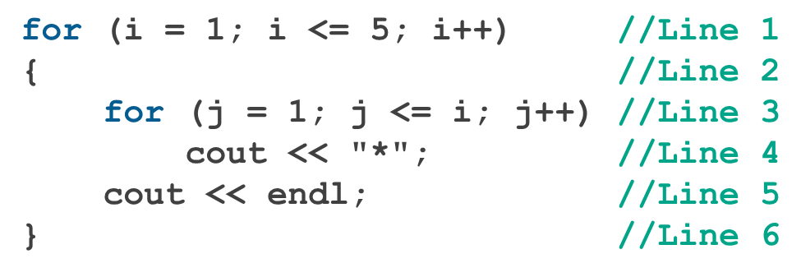
Nested Loop
To create the following pattern:
We can use the following code:

Slide 14
User-Defined Functions

Slide 15
Introduction
Functions allow complicated programs to be divided into manageable pieces
Functions are often called modules
Modules are easier to test
Allows collaboration
Write once, use many times

Slide 16
Predefined Functions
Some of the predefined mathematical functions are:
pow(x, y)
sqrt(x)
floor(x)
Predefined functions are organized into separate libraries
I/O functions are in iostream header
Math functions are in cmath header
https://replit.com/@btaylan/CISC3142Codes#Lecture-4/9.cpp

Slide 17
User-Defined Functions
Value-returning functions have a return type
Return a value of a specific data type using the return statement
Void functions do not have a return type
Do not use a return statement to return a value

Slide 18

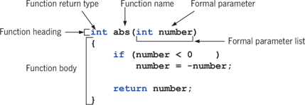
Value-Returning Functions
The syntax of a value-returning function is:

Slide 19

Function Call
Syntax to call a value-returning function
For example, x = abs(-5); // the function abs is called.

Slide 20

return Statement
A function returns its value via the return statement
It passes this value outside the function
When a return statement executes
the function immediately terminates
Control goes back to the caller
When a return statement executes in the function main, the program terminates
https://replit.com/@btaylan/CISC3142Codes#Lecture-4/10.cpp

Slide 21
Function Prototype
A function prototype is the function heading without the body of the function
It is not necessary to specify the variable name in the parameter list
The data type of each parameter must be specified
Programmers tend to write user defined functions after main method. In order to call methods in main, they must be declared first.
https://replit.com/@btaylan/CISC3142Codes#Lecture-4/11.cpp

Slide 22
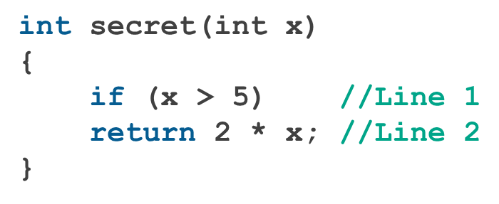
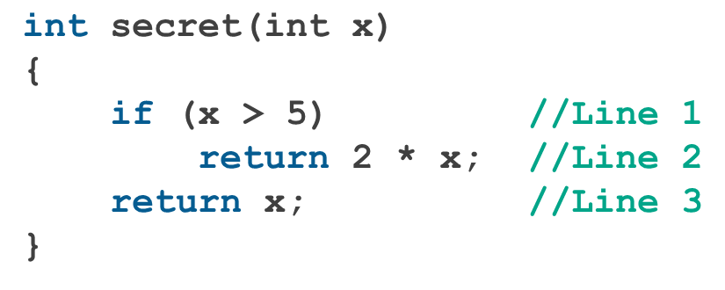
Value-Returning Functions: Some Peculiarities
A correct definition of the function secret is:

Slide 23
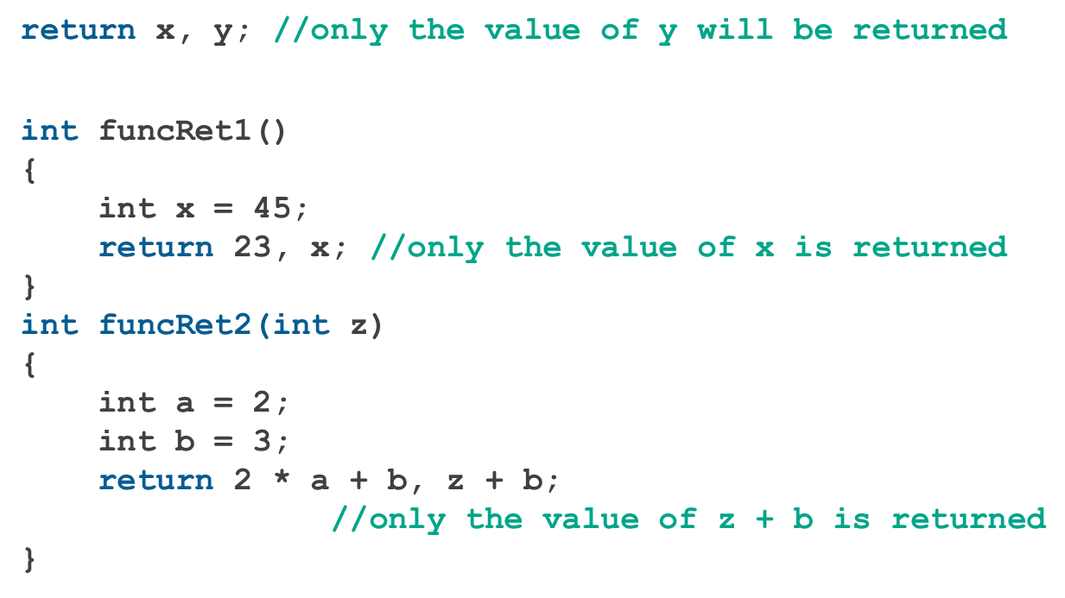
Value-Returning Functions: Some Peculiarities
Examples pointing out that the return statement only returns one value
https://replit.com/@btaylan/CISC3142Codes#Lecture-4/12.cpp

Slide 24
More Examples of Value-Returning Functions
Grade calculator :
https://replit.com/@btaylan/CISC3142Codes#Lecture-4/13.cpp
Find maximum of 10 numbers entered by user.
https://replit.com/@btaylan/CISC3142Codes#Lecture-4/14.cpp

Slide 25
Flow of Compilation and Execution
Execution begins in the function main
Other functions are executed only when called
Function prototypes appear before any function definition
When the end of a called function is executed, control is passed back to the point immediately following the function call

Slide 26
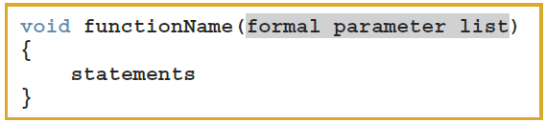

Void Functions
A void function does not have a return type
Function call syntax
https://replit.com/@btaylan/CISC3142Codes#Lecture-4/15.cpp

Slide 27
Types of formal parameters of Void Functions
Value parameter: a formal parameter that receives a copy of the content of corresponding actual parameter
https://replit.com/@btaylan/CISC3142Codes#Lecture-4/16.cpp
2) Reference parameter: a formal parameter that receives the location (memory address) of the corresponding actual parameter
https://replit.com/@btaylan/CISC3142Codes#Lecture-4/17.cpp
https://replit.com/@btaylan/CISC3142Codes#Lecture-4/18.cpp

Slide 28
Value and Reference Parameters and Memory Allocation
When a function is called:
Memory for its formal parameters and its local variables is allocated in the function data area
For a value parameter, the actual parameter’s value is copied into the formal parameter’s memory cell
Changes to the formal parameter do not affect the actual parameter’s value

Slide 29
Value and Reference Parameters and Memory Allocation
For a reference parameter, the actual parameter’s address passes to the formal parameter
Both formal and actual parameters refer to the same memory location
During execution, any change made to the formal parameter’s value immediately changes the actual parameter’s value

Slide 30
Reference Parameters and Value-Returning Functions
Reference parameters can be used in a value-returning functions too
But not recommended
Because by definition, a value-returning function returns a single value via return statement (reference already changes the value, why return again?)
If a function needs to return more than one value, change it to a void function and use reference parameters to return the values

